Slide 1
Behavioural Symptoms of Dementia
QUALITY STANDARDS
Guiding evidence-based care for people with dementia in hospitals and long-term care homes in Ontario
Notes:
If you have any questions about the content of this presentation, please contact us at QualityStandards@OntarioHealth.ca

Slide 2
Objectives
Overview of quality standards: What are they? How are they used?​
Why this quality standard is needed: Gaps and variations in quality of care for people with dementia in Ontario
Quality statements to improve care: The key statements in the behavioural symptoms of dementia quality standard
Measures to support improvement: Indicators that can help measure your quality improvement efforts

Slide 3
Quality standards
Inform clinicians and patients what quality care looks like
Focus on conditions or processes where there are large variations in how care is delivered, or where there are gaps between the care provided in Ontario and the care patients should receive
Are grounded in the best available evidence
Notes:
Quality standards are a small set of high impact statements that describe optimal care where identified quality gaps exist in Ontario.
Voluntary and aspirational in nature​.
Designed to “raise the ceiling” with the goal of having the best possible care available to all Ontarians, regardless of where they live in the province.
There are many guidelines, professional standards, and other recommendations that contribute to the evidence ecosystem. Quality standards complement these resources.
Quality standards outline the what of care that should be delivered but are agnostic on who should be delivering it (unlike other CPGs, BPGs).
Quality standards are:
Concise: 5 to 15 strong, evidence-based statements focused on high-priority areas for improvement.
Accessible: help clinicians and provider organizations offer the highest-quality care; and patients to know what to discuss with their clinicians (compared with CPGs that are quite dense, these are very accessible, also written in plain language).
Measurable: each statement is accompanied by one or more quality indicators (structure, process, or outcome), with a set of outcome measures for the overall standard.
Implementable: quality improvement tools and resources support each standard, to fuel adoption.

Slide 4
Quality standards
Help patients, residents, families, and care partners know what to ask for in their care
Help clinicians know what care to offer, based on evidence and expert consensus
Help health care organizations measure, assess, and improve the quality of care they provide
Help ensure consistent, high-quality care across the province
Notes:
Patients, care partners, and the public can use quality standards to understand what excellent care looks like, what they should expect from their clinicians, and how to discuss the quality of their care.
Provincial regions and disease agencies can use quality standards to measure health outcomes, hold health service providers accountable for delivering high-quality care, and inform regional improvement strategies.
Provider organizations can use quality standards to measure and audit their quality of care, identify gaps, guide organizational improvement strategies, and inform clinical program investments.
Clinicians can use quality standards to evaluate their practice and identify areas for personal and organizational quality improvement, and can incorporate the evidence-based statements into professional education.
Government can use quality standards to identify provincial priority areas, inform new data collection and reporting initiatives, and design performance indicators and funding incentives.

Slide 5
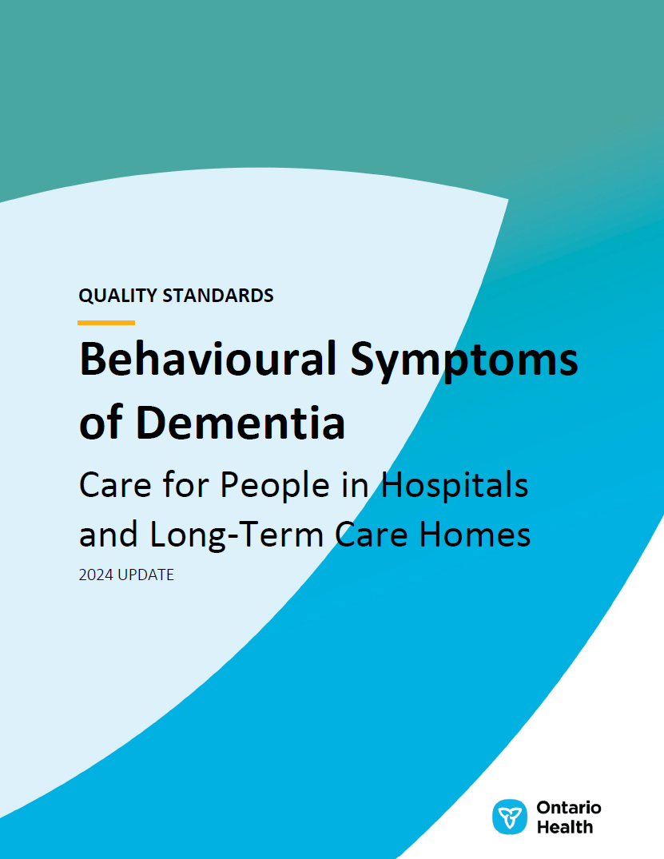
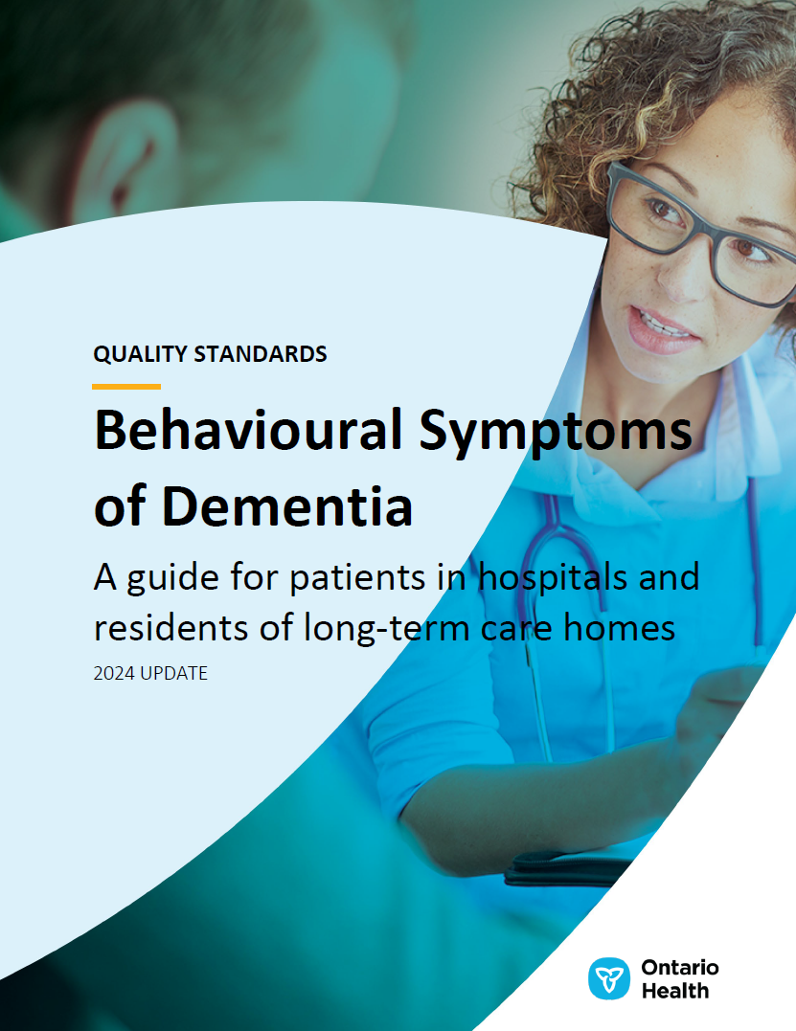
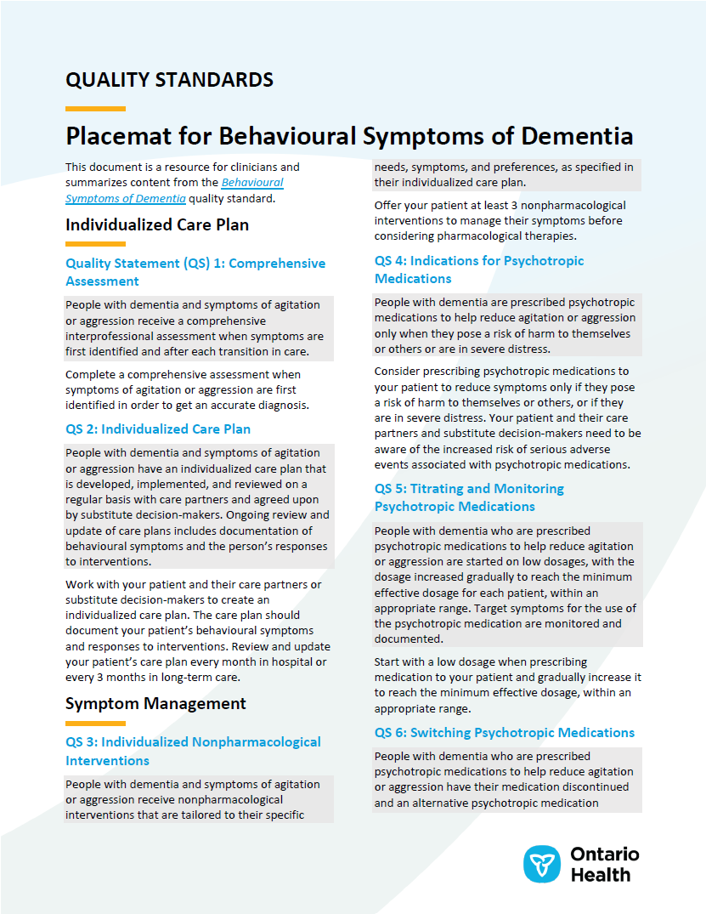
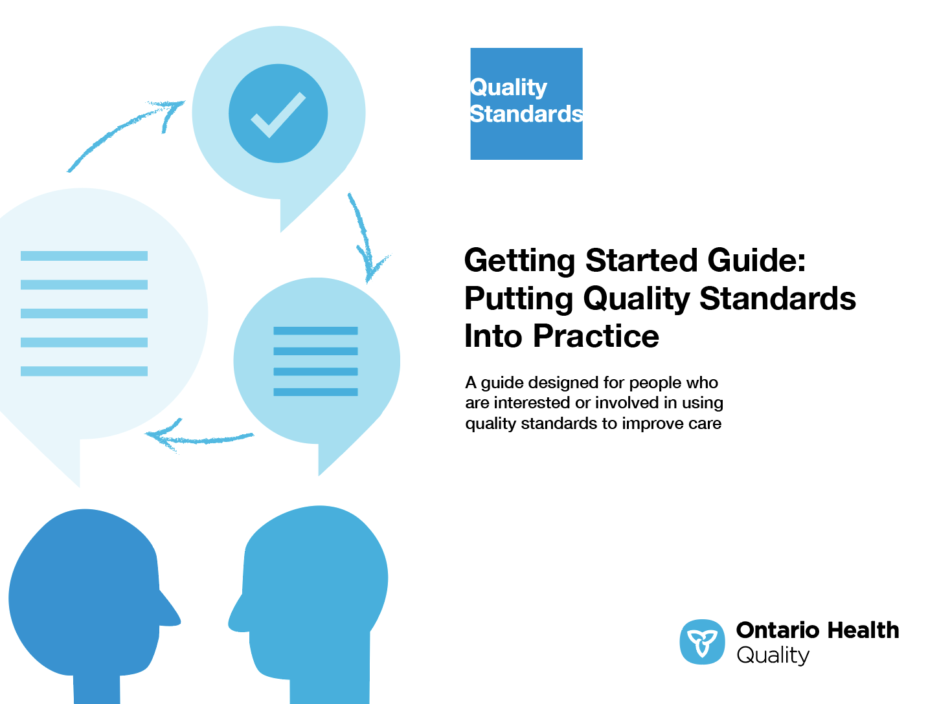
Quality standard resources
Quality Standard
Patient Guide
Placemat
Case for Improvement Deck
Measurement Guide
Technical Specifications
Getting Started Guide
Find these resources here: https://www.hqontario.ca/evidence-to-improve-care/quality-standards/view-all-quality-standards/behavioural-symptoms-of-dementia
Notes:
Each quality standard focuses on a specific health care issue. The development of each quality standard is accompanied by an assortment of resources.
Through concise, easy-to-understand statements, quality standards outline what quality care looks like for a condition or topic based on the evidence.
Each quality standard is accompanied by a:
Patient guide
Placemat
Case for Improvement deck
Measurement guide
Technical specifications
Getting started guide
Quality standards provide the blueprint to enable the health care system in Ontario to work better, facilitate smooth transitions, and ensure patients receive the same high-quality care, regardless of where they reside.

Slide 6
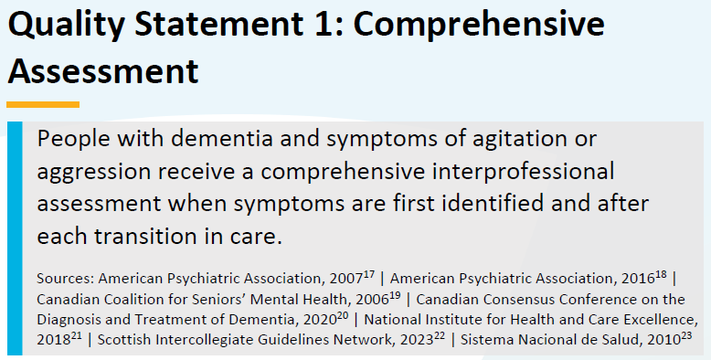
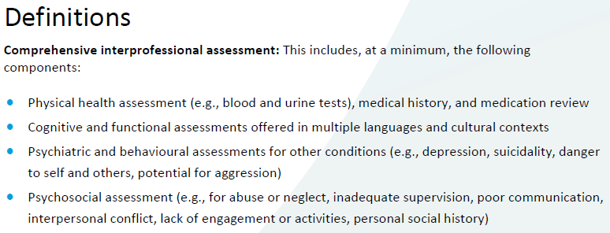
Inside the quality standard
The Quality Statement
The Audience Statements
The Definitions
The Indicators

Slide 7
Patient guide
Quality standards
The patient guide is designed to give patients information about what quality care looks like for various conditions based on the best evidence, so they can ask informed questions of their health care teams.
Notes:
Every quality standard includes a plain language summary for patients, families, care partners and the public called the patient guide.
Patient engagement in quality standards:
Membership on advisory committees
Focus groups and key informant interviews on topic-specific content (when necessary)
Public comment period for each quality standard
Consultations on the patient guide

Slide 8
Placemat
Quality standards
The placemat is a quick-reference resource for clinicians that summarizes the quality standard and includes links to helpful resources and tools.

Slide 9
Case for improvement deck
Quality standards
The case for improvement deck describes why the quality standard was created and shows some of the data used to develop it. Champions can use or adapt this deck to build support for the quality standard in their organizations.

Slide 10
How the health care system can support implementation
Quality standards
Implementing quality standards can be challenging owing to system-level barriers or gaps, many of which have been identified throughout the development of this standard
Ontario Health will work with and support other provincial partners, including the Ministry of Health, to bridge system-level gaps and support the implementation of quality standards

Slide 11
Implementation tools
Quality standards
The Getting Started Guide:
Outlines the process for using the quality standard as a resource to deliver high-quality care
Contains evidence-based approaches, as well as useful tools and templates for implementing change ideas at the practice level
Notes:
There are things we can do today despite the larger systemic barriers that may take time to resolve. The Getting Started Guide is a document that outlines a process for using the quality standards as a resource to deliver high-quality care. It compiles a number of resources to support adoption, such as links to implementation and quality improvement resources, examples and activities for reflection, and templates and documents to support the implementation planning activities. The Getting Started Guide also includes an Action Plan Template and examples on how Quality Improvement Plans can help to advance quality standards.

Slide 12
Quorum
Quality standard adoption tools
Quorum is an online community dedicated to improving the quality of health care in Ontario.
The Quality Standards Adoption Series highlights efforts in the field to implement changes and close gaps in care related to quality standard topics.
quorum.hqontario.ca
Notes:
The Quality Standards program has highlighted several stories from organizations and groups using various standards and statements within their clinical care settings, organization, or institutions; these are available through posts and discussions on Quorum.
As well, we are working on compiling resources and tools, for both clinicians and patients and families.
The focus is on implementation/adoption stories and how organizations are using quality standards in practice to inform care.
We’d love to hear from you if you are interested in contributing to a post or article.

Slide 13
Measurement guide
Quality standards
The measurement guide describes:
The measurement principles behind the quality indicators included in quality standards
The types of indicators included in quality standards
How local and provincial data are collected and measured

Slide 14
Technical specifications
Quality standards
The technical specifications report outlines 2 types of measurement:
Provincial measurement: how we can monitor the progress being made to improve care at the provincial level
Local measurement: what you can do to assess the quality of care that you provide locally

Slide 15
Why do we need a quality standard for behavioural symptoms of dementia?

Slide 16
About 80% of people with dementia living in LTC homes display symptoms of aggression at some stage of their dementia.¹
Symptoms of agitation and aggression are a major cause of hospitalization and transfers to LTC homes.²⁻⁴
Abbreviation: LTC, long-term care.
Sources:
Brodaty H, Draper B, Saab D, Low LF, Richards V, Paton H, et al. Psychosis, depression and behavioural disturbances in Sydney nursing home residents: prevalence and predictors. Int J Geriatr Psychiatry. 2001;16(5):504-12.
O’Donnell BF, Drachman DA, Barnes HJ, Peterson KE, Swearer JM, Lew RA. Incontinence and troublesome behaviors predict institutionalization in dementia. J Geriatr Psychiatry Neurol. 1992;5(1):45-52.
Wancata J, Windhaber J, Krautgartner M, Alexandrowicz R. The consequences of non-cognitive symptoms of dementia in medical hospital departments. Int J Psychiatry Med. 2003;33(3):257-71.
Yaffe K, Fox P, Newcomer R, Sands L, Lindquist K, Dane K, et al. Patient and caregiver characteristics and nursing home placement in patients with dementia. JAMA. 2002;287(16):2090-7.

Slide 17
The majority of LTC residents live with dementia
Over 40% of LTC residents with dementia had at least 1 incident of aggressive behaviour in fiscal year 2022/23.
57%
Note: A resident with an incident of aggression is defined as having 1 or more occurrence of verbal or physical aggression or agitation on any resident assessment in a given fiscal year.
Source: Continuing Care Reporting System (Canadian Institute for Health Information).

Slide 18
Only 11.4% of LTC residents with dementia experienced an improvement in behavioural symptoms of aggression between their 2 latest assessments in fiscal year 2022/23
Note: Improvement is defined as a decrease in the frequency of occurrences of verbal or physical aggression between the 2 latest assessments in a given fiscal year.
Source: Continuing Care Reporting System (Canadian Institute for Health Information).

Slide 19
About 800 people with dementia are admitted to inpatient mental health beds annually, representing 1.4% of all people admitted each year.
Patients with dementia typically spend 31 days
in a mental health bed – much longer than the average patient in a mental health bed (8 days).
Sources: Ontario Health Dementia in Mental Health Facilities Cohort and Ontario Mental Health Reporting System (Canadian Institute for Health Information).

Slide 20
About 27% of mental health inpatients with dementia experienced an improvement in behavioural symptoms of aggression between admission and discharge in fiscal year 2022/23
Note: Improvement is defined as a decrease in the frequency of occurrences of verbal or physical aggression between the admission and discharge assessments in a given fiscal year.
Source: Ontario Mental Health Reporting System (Canadian Institute for Health Information).

Slide 21
Approximately 40% of people with dementia admitted to an inpatient mental health bed in fiscal year 2022/23 were admitted after undergoing a psychiatric evaluation under the Mental Health Act (Form 1)
Note: The Mental Health Act (Form 1) is a legal document filed by a physician ordering a psychiatric evaluation for a patient, after which they can be admitted to an inpatient mental health bed either voluntarily or involuntarily.
Source: Ontario Mental Health Reporting System (Canadian Institute for Health Information).

Slide 22
Differences in the prescription of antipsychotic medications and the use of physical restraints for people with dementia have been observed across LTC homes in Ontario, highlighting variation in how care is delivered.^{1,2}
Sources:
Health Quality Ontario. Looking for balance: antipsychotic medication use in Ontario long-term care homes [Internet]. Toronto (ON): Queen’s Printer for Ontario; 2015 [cited 2016 Apr 8]. Available from: http://www.hqontario.ca/portals/0/Documents/pr/looking-for-balance-en.pdf
Health Quality Ontario. Long-term care sector performance: quality indicators [Internet]. Toronto (ON): Queen’s Printer for Ontario; 2016 [cited 2016 Apr 8]. Available from: http://www.hqontario.ca/System-Performance/Long-Term-Care-Sector-Performance/Quality-Indicators

Slide 23
In fiscal year 2022/23, there was a dementia diagnosis associated with 0.33% of ED visits
The proportion of unplanned ED visits with a dementia diagnosis has increased slightly since the start of the COVID-19 pandemic. Unplanned ED visits reflect health service use patterns for people with dementia at a population level.
Abbreviation: ED, emergency department.
Note: The denominator for the rate is restricted to unplanned visit to an ED.
Source: National Ambulatory Care Reporting System (Canadian Institute for Health Information), fiscal years 2017/18 to 2022/23.

Slide 24
The percentage of unplanned ED visits with a dementia diagnosis varies across regions in Ontario
East (0.41%) and Toronto (0.43%) regions had the highest percentages of unplanned ED visits with a dementia diagnosis. This may reflect differences in patient demographics or access to EDs.
Notes: The denominator for the rate is restricted to unplanned visit to an ED. Ontario Health region is determined by the location of the ED.
Source: National Ambulatory Care Reporting System (Canadian Institute for Health Information), fiscal year 2022/23.

Slide 25
The readmission rate for people with dementia in Ontario remains stable, from 13% in fiscal year 2017/18 to 12% in fiscal year 2022/23
Note: The index visit refers to the initial visit when the patient was diagnosed with dementia, while readmissions within 30 days encompass all causes; these readmissions may or may not be related to dementia.
Sources: Discharge Abstract Database and Ontario Mental Health Reporting System (Canadian Institute for Health Information), fiscal years 2017/18 to 2022/23. Owusu E, Oluwasina F, Nkire N, Lawal MA, Agyapong VIO. Readmission of patients to acute psychiatric hospitals: influential factors and interventions to reduce psychiatric readmission rates. Healthcare (Basel). 2022;10(9):1808.

Slide 26
Dementia was often a comorbidity to the main problem for which people were seeking care at the ED
In fiscal year 2022/23, 64% of ED visits with an associated dementia diagnosis had a different main diagnosis.
Note: The denominator for the rate is restricted to unplanned visit to an ED.
Source: National Ambulatory Care Reporting System (Canadian Institute for Health Information), fiscal year 2022/23.

Slide 27
Quality statements to improve care

Slide 28
Scope of this quality standard
This quality standard addresses care for people with dementia and the specific behaviours of agitation or aggression who are in an emergency department, admitted to a hospital, or in a long-term care home. It also provides guidance on the care given when a person is transitioned between these settings; for example, when someone is discharged from a hospital to a long-term care home.
This quality standard does not address care for people with dementia living in the community, nor does it address care for people with mild cognitive impairment.
For a quality standard that addresses care for people with dementia in the community, refer to Dementia: Care for People Living in the Community.
Notes:
Scope of This Quality Standard
This quality standard addresses care for people with dementia and the specific behaviours of agitation or aggression who are in an emergency department, admitted to a hospital, or in a long-term care home. It also provides guidance on the care given when a person is transitioned between these settings; for example, when someone is discharged from a hospital to a long-term care home.
A separate quality standard addresses care for people with dementia in the community.

Slide 29
Quality statement topics
Comprehensive assessment
Individualized care plan
Individualized nonpharmacological interventions
Indications for psychotropic medications
Titrating and monitoring psychotropic medications
Switching psychotropic medications
Medication review for dosage reduction or discontinuation
Physical restraint
Informed consent
Specialized interprofessional care team
Education and training for clinicians
Education and training for care partners
Appropriate care environment
Transitions in care

Slide 30
Comprehensive assessment
Quality statement 1:
People with dementia and symptoms of agitation or aggression receive a comprehensive interprofessional assessment when symptoms are first identified and after each transition in care.

Slide 31
Individualized care plan
Quality statement 2:
People with dementia and symptoms of agitation or aggression have an individualized care plan that is developed, implemented, and reviewed on a regular basis with care partners and agreed upon by substitute decision-makers. Ongoing review and update of care plans includes documentation of behavioural symptoms and the person’s responses to interventions.

Slide 32
Individualized nonpharmacological interventions
Quality statement 3:
People with dementia and symptoms of agitation or aggression receive nonpharmacological interventions that are tailored to their specific needs, symptoms, and preferences, as specified in their individualized care plan.

Slide 33
Indications for psychotropic medications
Quality statement 4:
People with dementia are prescribed psychotropic medications to help reduce agitation or aggression only when they pose a risk of harm to themselves or others or are in severe distress.

Slide 34
Titrating and monitoring psychotropic medications
Quality statement 5:
People with dementia who are prescribed psychotropic medications to help reduce agitation or aggression are started on low dosages, with the dosage increased gradually to reach the minimum effective dosage for each patient, within an appropriate range. Target symptoms for the use of the psychotropic medication are monitored and documented.

Slide 35
Switching psychotropic medications
Quality statement 6:
People with dementia who are prescribed psychotropic medications to help reduce agitation or aggression have their medication discontinued and an alternative psychotropic medication prescribed if symptoms do not improve after a maximum of 8 weeks. Ineffective medications are discontinued to avoid polypharmacy. The reasons for the changes in medication and the consideration of alternative psychotropic medications are documented.

Slide 36
Medication review for dosage reduction or discontinuation
Quality statement 7:
People with dementia who are prescribed psychotropic medications to help reduce agitation or aggression receive a documented medication review on a regular basis to consider reducing the dosage or discontinuing the medication.

Slide 37
Physical restraint
Quality statement 8:
People with dementia are not physically restrained to manage symptoms of agitation or aggression.

Slide 38
Informed consent
Quality statement 9:
People with dementia and symptoms of agitation or aggression are advised of the risks and benefits of treatment options, and informed consent is obtained and documented before treatment is initiated. If a person with dementia is incapable of consenting to the proposed treatment, informed consent is obtained from their substitute decision-maker.

Slide 39
Specialized interprofessional care team
Quality statement 10:
People with dementia and symptoms of agitation or aggression have access to services from an interprofessional team that provides specialized care for the behavioural and psychological symptoms of dementia.

Slide 40
Education and training for clinicians
Quality statement 11:
People with dementia and symptoms of agitation or aggression receive care from clinicians with education and training in the assessment and management of dementia and its behavioural symptoms.

Slide 41
Education and training for care partners
Quality statement 12:
Care partners of people with dementia and symptoms of agitation or aggression have access to comprehensive education and training on dementia and its associated behavioural symptoms. This education and training includes management strategies that are consistent with people’s care plans.

Slide 42
Appropriate care environment
Quality statement 13:
People with dementia and symptoms of agitation or aggression whose behavioural symptoms have been successfully treated are transitioned to an appropriate care environment as soon as possible.

Slide 43
Transitions in care
Quality statement 14:
People with dementia and symptoms of agitation or aggression who transition between settings have a health care team or clinician who is accountable for coordination and communication. This team or clinician ensures the transmission of complete and accurate information to the family, care partners, and receiving health care team prior to the transition.

Slide 44
Measures to support improvement
Notes:
The Behavioural Symptoms of Dementia Quality Standard Advisory Committee identified a set of overarching goals for this quality standard. These have been mapped to indicators that may be used to assess quality of care provincially and locally.

Slide 45
Indicators that can be measured using provincial data
Percentage of people in long-term care homes with dementia and symptoms of agitation or aggression who experience fewer or less frequent behavioural symptoms
Percentage of people in complex continuing care with dementia and symptoms of agitation or aggression who experience fewer or less frequent behavioural symptoms
Percentage of people in inpatient mental health beds with dementia and symptoms of agitation or aggression who experience fewer or less frequent behavioural symptoms
Percentage of people with dementia and symptoms of agitation or aggression who are admitted to mental health beds in hospital under the Mental Health Act (Form 1)
Percentage of people with dementia who are readmitted to hospital within 30 days of hospital discharge
Rate of emergency department use by people with dementia, per 1,000 emergency department visits

Slide 46
Indicators that can be measured using only local data
Number of incidents in hospitals and long-term care homes related to symptoms of aggression in dementia: patient-on-patient or patient-on-staff incidents
Percentage of long-term care home placement applications that are rejected by a long-term care home owing to an inability to meet client care needs

Slide 47
Data sources and acknowledgement
Parts of this material are based on data and information compiled and provided by the Canadian Institute for Health Information (CIHI). However, the analyses, conclusions, opinions, and statements expressed herein are those of the authors and not necessarily those of CIHI.

Slide 48
Thank you

