Slide 1
Insomnia Disorder
QUALITY STANDARDS
Guiding evidence-based care for people in Ontario
Notes:
If you have any questions about the content of this presentation, please contact us at QualityStandards@OntarioHealth.ca

Slide 2
Objectives
Overview of quality standards: What are they? How are they used?​
Why this quality standard is needed: Gaps and variations in quality of care for people with insomnia disorder in Ontario
Quality statements to improve care: The key statements in the insomnia disorder quality standard
Measures to support improvement: Indicators that can help measure your quality improvement efforts

Slide 3
Quality standards
Inform clinicians and patients what quality care looks like
Focus on conditions or processes where there are large variations in how care is delivered, or where there are gaps between the care provided in Ontario and the care patients should receive
Are grounded in the best available evidence
3
Notes:
Quality standards are a small set of high-impact statements that describe optimal care where identified quality gaps exist in Ontario.
Voluntary and aspirational in nature​.
Designed to “raise the ceiling” with the goal of having the best possible care available to all Ontarians, regardless of where they live in the province.
There are many guidelines, professional standards, and other recommendations that contribute to the evidence ecosystem. Quality standards complement these resources.
Quality standards outline the what of care that should be delivered but are agnostic on who should be delivering it (unlike other CPGs, BPGs).
Quality standards are:
Concise: 5 to 15 strong, evidence-based statements focused on high-priority areas for improvement.
Accessible: help clinicians and provider organizations offer the highest-quality care; and patients to know what to discuss with their health care team (compared with CPGs that are quite dense, these are very accessible, also written in plain language).
Measurable: each statement is accompanied by one or more quality indicators (structure, process, or outcome), with a set of outcome measures for the overall standard.
Implementable: quality improvement tools and resources support each standard, to fuel adoption.

Slide 4
Quality standards
Help patients, residents, families, and care partners know what to ask for in their care
Help clinicians know what care to offer, based on evidence and expert consensus
Help health care organizations measure, assess, and improve the quality of care they provide
Help ensure consistent, high-quality care across the province
4
Notes:
Patients, caregivers and the public can use quality standards to understand what excellent care looks like, what they should expect from their health care team, and how to discuss the quality of their care.
Provincial regions and disease agencies can use quality standards to measure health outcomes, hold health service providers accountable for delivering high-quality care, and inform regional improvement strategies.
Provider organizations can use quality standards to measure and audit their quality of care, identify gaps, guide organizational improvement strategies, and inform clinical program investments.
Clinicians can use quality standards to evaluate their practice and identify areas for personal and organizational quality improvement, and can incorporate the evidence-based statements into professional education.
Government can use quality standards to identify provincial priority areas, inform new data collection and reporting initiatives, and design performance indicators and funding incentives.

Slide 5
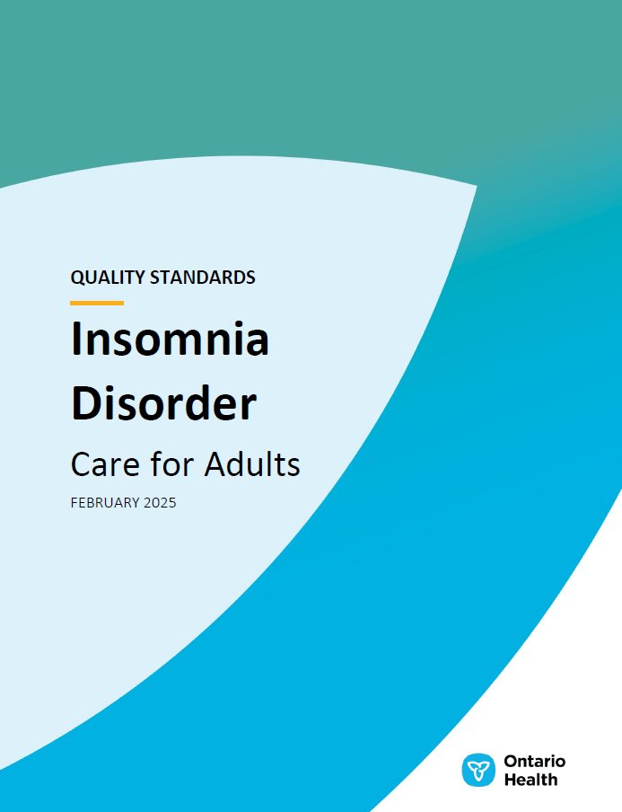
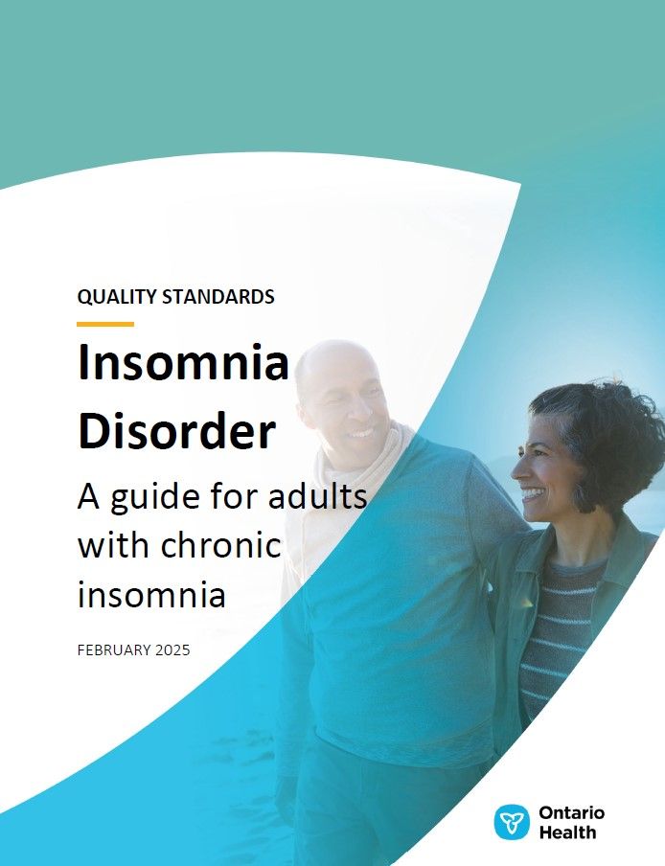
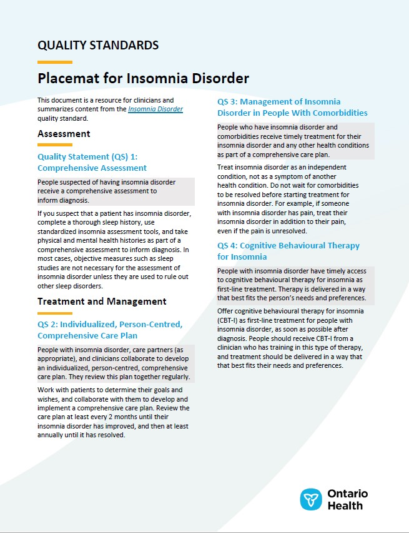
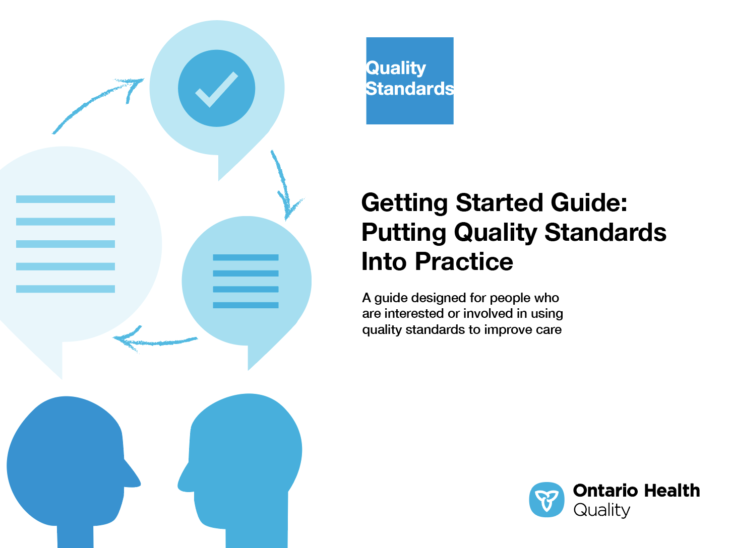
Quality standard resources
Quality Standard
Patient Guide
Placemat
Case for Improvement Deck
Measurement Guide
Technical Specifications
Getting Started Guide
5
Find these resources here: https://www.hqontario.ca/Evidence-to-Improve-Care/Quality-Standards/View-All-Quality-Standards/Insomnia-Disorder
Notes:
Each quality standard focuses on a specific health care issue. The development of each quality standard is accompanied by an assortment of resources.
Through concise, easy-to-understand statements, quality standards outline what quality care looks like for a condition or topic based on the evidence.
Each quality standard is accompanied by a:
Patient guide
Placemat
Case for Improvement Deck
Measurement guide
Technical specifications
Getting started guide
Quality standards provide the blueprint to enable the health care system in Ontario to work better, facilitate smooth transitions, and ensure patients receive the same high-quality care, regardless of where they reside.

Slide 6
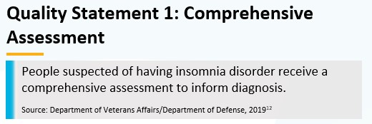
Inside the quality standard
The Quality Statement
The Audience Statements
The Definitions
The Indicators
6

Slide 7
Patient guide
Quality standards
The patient guide is designed to give patients information about what quality care looks like for various conditions based on the best evidence, so they can ask informed questions of their health care teams.
7
Notes:
Every quality standard includes a plain language summary for patients, families, caregivers and the public called the patient guide.
Patient engagement in quality standards:
Membership on advisory committees
Focus groups and key informant interviews on topic-specific content (when necessary)
Public comment period for each quality standard
Consultations on the patient guide

Slide 8
Placemat
Quality standards
The placemat is a quick-reference resource for clinicians that summarizes the quality standard and includes links to helpful resources and tools.
8

Slide 9
Case for improvement deck
Quality standards
The case for improvement deck describes why the quality standard was created and shows some of the data used to develop it. Champions can use or adapt this deck to build support for the quality standard in their organizations.
9

Slide 10
How the health care system can support implementation
Quality standards
Implementing quality standards can be challenging owing to system-level barriers or gaps, many of which have been identified throughout the development of this standard
Ontario Health will work with and support other provincial partners, including the Ministry of Health, to bridge system-level gaps to support the implementation of quality standards

Slide 11
Implementation tools
Quality standards
The Getting Started Guide:
Outlines the process for using the quality standard as a resource to deliver high-quality care
Contains evidence-based approaches, as well as useful tools and templates for implementing change ideas at the practice level
11
Notes:
There are things we can do today despite the larger systemic barriers that may take time to resolve. The Getting Started Guide is a document that outlines a process for using the quality standards as a resource to deliver high-quality care. It compiles a number of resources to support adoption, such as links to implementation and quality improvement resources, examples and activities for reflection, and templates and documents to support the implementation planning activities. The Getting Started Guide also includes an Action Plan Template and examples on how Quality Improvement Plans can help to advance quality standards.

Slide 12
Quorum
Quality standards
Quorum is an online community dedicated to improving the quality of health care in Ontario.
The Quality Standards Adoption Series highlights efforts in the field to implement changes and close gaps in care related to quality standard topics.
quorum.hqontario.ca
12
Notes:
The Quality Standards program has highlighted several stories from organizations and groups using various standards and statements within their clinical care settings, organization, or institutions; these are available through posts and discussions on Quorum.
As well, we are working on compiling resources and tools, for both clinicians and patients and families.
The focus is on implementation/adoption stories and how organizations are using quality standards in practice to inform care.
We’d love to hear from you if you are interested in contributing to a post or article.

Slide 13
Measurement guide
Quality standards
The measurement guide describes:
The measurement principles behind the quality indicators included in quality standards
The types of indicators included in quality standards
How local and provincial data are collected and measured
13

Slide 14
Technical specifications
Quality standards
The technical specifications report outlines 2 types of measurement:
Provincial measurement: how we can monitor the progress being made to improve care at the provincial level
Local measurement: what you can do to assess the quality of care that you provide locally
14

Slide 15
Why do we need a quality standard for insomnia disorder?

Slide 16
1 in 5 adults in Canada have insomnia
In 2021 among adults in Ontario¹:
20% reported insomnia; 61% of those were women, and 39% were men
5% found it difficult to stay awake when they wanted to
Lower socioeconomic status has been associated with poorer sleep^{2,3}:
Factors directly affecting sleep include irregular work hours (disturbing the circadian rhythm) and living in noisy or unsafe environments
Factors indirectly affecting sleep include stress, health behaviours, and comorbidities that disproportionately affect people from lower socioeconomic backgrounds
In the Canadian Community Health Survey, insomnia was defined as having reported trouble going to sleep or staying asleep most of or all the time.
1. Canadian Community Health Survey, Ontario Share File, 2021.
2. Chaput JP, Tomfohr-Madsen LM, Carney CE, et al. Examining sleep characteristics in Canada through a diversity and equity lens. Sleep Health. 2024;10(3):316-20.
3. Jehan S, Myers AK, Zizi F, et al. Sleep health disparity: the putative role of race, ethnicity and socioeconomic status. Sleep Med Disord. 2018;2(5):127-33.

Slide 17
Insomnia affects daily living
People with insomnia are more likely to report dissatisfaction with life, psychological distress, poor or fair mental health, poor energy levels, and limited social functioning.^{1,2}
Other impacts include vehicular accidents, workplace accidents and injuries, and work absenteeism.³
*Significantly higher (P < .05)
1. Rodrigues R, Nicholson K, Guaiana G, Wilk P, Stranges S, Anderson KK. Sleep problems and psychological well-being: baseline findings from the Canadian Longitudinal Study on Aging. Can J Aging. 2023;42(2):230-40.
2. Lee M, Choh AC, Demerath EW, et al. Sleep disturbance in relation to health-related quality of life in adults: the Fels Longitudinal Study. J Nutr Health Aging. 2009;13(6):576-83.
3. Chaput JP, Janssen I, Sampasa-Kanyinga H, et al. Economic burden of insomnia symptoms in Canada. Sleep Health. 2023;9(2):185-9.
4. Canadian Community Health Survey, Ontario Share File, 2021.

Slide 18
Societal impact of insomnia
In Canada in 2021, the economic impact of insomnia in relation to people with comorbid chronic conditions was estimated to be $1.9 billion CAD. This includes direct health care costs and indirect costs in the labour force.¹
It was estimated that a 5% reduction in insomnia symptoms in the population would save at least $353 million CAD per year.¹
In a global study, the estimated annual GDP loss due to insomnia in Canada was $19.6 billion USD ($26 billion CAD) in 2019.²
GDP, gross domestic product.
1. Chaput JP, Janssen I, Sampasa-Kanyinga H, et al. Economic burden of insomnia symptoms in Canada. Sleep Health. 2023;9(2):185-9.
2. Hafner M, Romanelli RJ, Yerushalmi E, Troxel WM. The societal and economic burden of insomnia in adults: an international study [Internet]. Santa Monica (CA): RAND Corporation; 2023 [cited 2024 Dec 13]. Available from: www.rand.org/pubs/research_reports/RRA2166-1.html.

Slide 19
Insomnia is often comorbid with other health conditions
Insomnia is associated with higher risk of¹⁻³:
Type 2 diabetes
Cardiovascular disease
Cognitive decline
Cognitive disorders
Prospective studies show that people with insomnia have increased risk of^{4,5}:
Depression
Hypertension
1. Johnson KA, Gordon CJ, Chapman JL, et al. The association of insomnia disorder characterised by objective short sleep duration with hypertension, diabetes and body mass index: a systematic review and meta-analysis. Sleep Med Rev. 2021;59:101456.
2. Sofi F, Cesari F, Casini A, Macchi C, Abbate R, Gensini GF. Insomnia and risk of cardiovascular disease: a meta-analysis. Eur J Prev Cardiol. 2014;21(1):57-64.
3. Xu W, Tan CC, Zou JJ, Cao XP, Tan L. Sleep problems and risk of all-cause cognitive decline or dementia: an updated systematic review and meta-analysis. J Neurol Neurosurg Psychiatry. 2020;91(3):236-44.
4. Li L, Wu C, Gan Y, Qu X, Lu Z. Insomnia and the risk of depression: a meta-analysis of prospective cohort studies. BMC Psychiatry. 2016;16(1):375.
5. Wu TT, Zou YL, Xu KD, et al. Insomnia and multiple health outcomes: umbrella review of meta-analyses of prospective cohort studies. Public Health. 2023;215:66-74.

Slide 20
Select comorbidities reported by people with and without insomnia
*Significantly higher (P < .05)
Diabetes includes type 1, type 2, and gestational diabetes. Mood disorders include depression, bipolar disorder, mania, or dysthymia. Anxiety disorders include phobia, obsessive–compulsive disorder, or panic disorder.
Source: Canadian Community Health Survey, Ontario Share File, 2021.

Slide 21
CBT-I is recommended as first-line treatment for insomnia, but access to care needs improvement
People misunderstand the cause of their insomnia as being due to their lifestyle rather than to a disorder. This makes them feel responsible for not being able to have restful sleep.⁵
Among those with insomnia disorder:
There can be financial barriers to CBT-I^{1,2}
People often do not know how and where to seek care for their insomnia disorder³
People may be misinformed about insomnia treatment³
There are concerns with CBT-I as a management option for chronic insomnia because of perceived time constraints associated with treatment⁴
In Ontario, only 8.8% of adults with insomnia reported receiving health care regularly* from a psychologist or mental health professional in 2021⁶
Primary care clinicians report challenges connecting their patients to CBT-I care²
General barriers to mental health care that also affect insomnia treatment⁷:
Limited government funding
Inadequate integration between primary care and mental health care
Concerns about stigma
Culture and language barriers
CBT-I, cognitive behavioural therapy for insomnia.
*Defined as regularly seeing or talking to a health professional when health care or advice is needed.
1. Morin CM. Cognitive behavioural therapy for insomnia (CBTi): from randomized controlled trials to practice guidelines to implementation in clinical practice. J Sleep Res. 2020;29:e13017.
2. Insomnia Disorder Quality Standard Advisory Committee and public feedback.
3. Koffel E, Bramoweth AD, Ulmer CS. Increasing access to and utilization of cognitive behavioral therapy for insomnia (CBT-I): a narrative review. J Gen Intern Med. 2018;33(6):955-62.
4. Zhou ES, Mazzenga M, Gordillo ML, Meltzer LJ, Long KA. Sleep education and training among practicing clinical psychologists in the United States and Canada. Behav Sleep Med. 2021;19(6):744-53.
5. O'Regan D, Garcia-Borreguero D, Gloggner F, Wild I, Leontiou C, Ferini-Strambi L. Mapping the insomnia patient journey in Europe and Canada. Front Public Health. 2023;11:1233201.
6. Canadian Community Health Survey, Ontario Share File, 2021.
7. Moroz N, Moroz I, D’Angelo MS. Mental health services in Canada: barriers and cost-effective solutions to increase access. Healthc Manage Forum. 2020;33(6):282-7.

Slide 22
Need to improve clinicians’ knowledge about insomnia treatment
Clinicians often recommend using sleep hygiene to treat insomnia disorder, despite evidence demonstrating that sleep hygiene is ineffective as a standalone treatment^{1,2}
A 2019 online survey of clinical psychologists in the United States and Canada found that 64% recommended sleep hygiene to treat insomnia and only 17% offered CBT-I²
Clinicians may lack the necessary knowledge to treat insomnia: the same survey found that over 40% felt underprepared in terms of their ability to treat insomnia disorder²
Clinicians should follow clinical guidelines when considering medications to treat insomnia
Clinician resources
For a list of resources, please see the Placemat for Insomnia Disorder
CBT-I, cognitive behavioural therapy for insomnia.
1. Trauer JM, Qian MY, Doyle JS, Rajaratnam SM, Cunnington D. Cognitive behavioral therapy for chronic insomnia: a systematic review and meta-analysis. Ann Intern Med. 2015;163(3):191-204.
2. Zhou ES, Mazzenga M, Gordillo ML, Meltzer LJ, Long KA. Sleep education and training among practicing clinical psychologists in the United States and Canada. Behav Sleep Med. 2021;19(6):744-53.

Slide 23
Quality statements to improve care

Slide 24
Scope of this quality standard
This quality standard addresses care for adults aged 18 years or older who have insomnia disorder (also known as chronic insomnia). It applies to all health care settings
This quality standard does not include care for people whose sleeping difficulty is better explained by a different sleep disorder

Slide 25
Quality statement topics
Comprehensive assessment
Individualized, person-centred, comprehensive care plan
Management of insomnia disorder in people with comorbidities
Cognitive behavioural therapy for insomnia
Pharmacotherapy

Slide 26
Comprehensive assessment
Quality statement 1:
People suspected of having insomnia disorder receive a comprehensive assessment to inform diagnosis.
26

Slide 27
Individualized, person-centred, comprehensive care plan
Quality statement 2:
People with insomnia disorder, care partners (as appropriate), and clinicians collaborate to develop an individualized, person-centred, comprehensive care plan. They review this plan together regularly.
27

Slide 28
Management of insomnia disorder in people with comorbidities
Quality statement 3:
People who have insomnia disorder and comorbidities receive timely treatment for their insomnia disorder and any other health conditions as part of a comprehensive care plan.
28

Slide 29
Cognitive behavioural therapy for insomnia
Quality statement 4:
People with insomnia disorder have timely access to cognitive behavioural therapy for insomnia as first-line treatment. Therapy is delivered in a way that best fits the person’s needs and preferences.
29

Slide 30
Pharmacotherapy
Quality statement 5:
People with insomnia disorder are offered effective medications at the lowest possible dose, for the shortest possible duration, and after an adequate trial of CBT-I. A medication is offered only after a discussion about its benefits and risks.
CBT-I, cognitive behavioural therapy for insomnia.
30

Slide 31
Measures to support improvement

Slide 32
Indicators that can be measured using only local data
Percentage of people who report that their sleep has improved after treatment of their insomnia disorder
Percentage of people with insomnia disorder and taking insomnia medication who report that their medication was prescribed based on a documented discussion with their clinician
Percentage of people who report improved quality of life after treatment of their insomnia disorder
32

Slide 33
Data sources and acknowledgement
Some of the data used in this presentation were sourced from the Canadian Community Health Survey Ontario Share Files, developed by Statistics Canada and provided by Ontario’s Ministry of Health. However, the analyses, conclusions, opinions, and statements expressed herein are those of the authors and not necessarily those of the Ontario Ministry of Health or Statistics Canada.
33

Slide 34
Thank you

