Slide 1
Low Back Pain
QUALITY STANDARDS
Guiding evidence-based care for adults with acute low back pain in Ontario

Slide 2
Objectives
Overview of quality standards: What are they? How are they used?​
Why this quality standard is needed: Gaps and variations in quality of care for adults with acute low back pain in Ontario
Quality statements to improve care: The key statements in the acute low back pain quality standard
Measures to support improvement: Indicators that can help measure your quality improvement efforts

Slide 3
Quality standards
Inform clinicians and patients what quality care looks like
Focus on conditions or processes where there are large variations in how care is delivered, or where there are gaps between the care provided in Ontario and the care patients should receive
Are grounded in the best available evidence

Slide 4
Benefits of quality standards
Help patients, residents, families, and care partners know what to ask for in their care
Help clinicians know what care to offer, based on evidence and expert consensus
Help health care organizations measure, assess, and improve the quality of care they provide
Help ensure consistent, high-quality care across the province

Slide 5
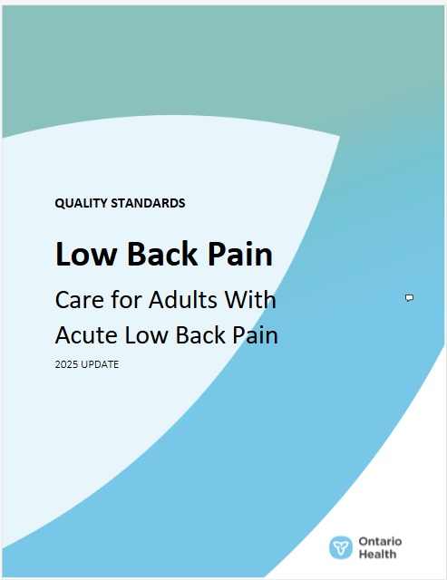
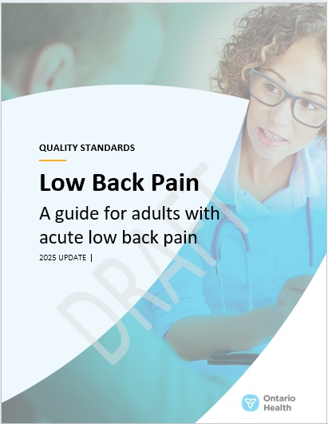
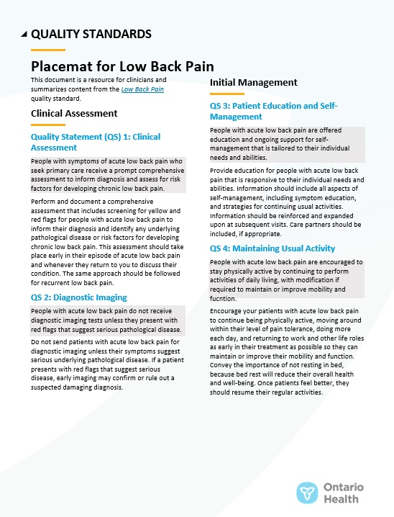
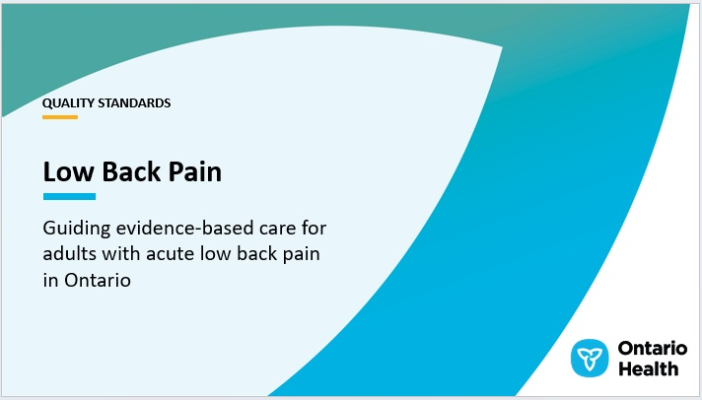

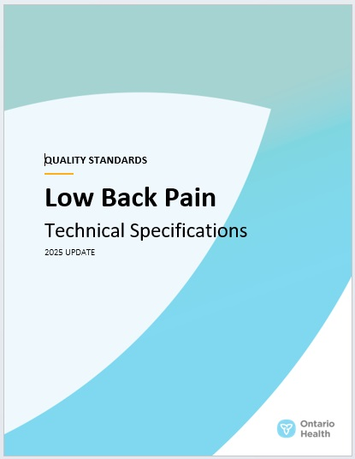

Quality standard resources
Quality Standard
Patient Guide
Placemat
Case for Improvement Deck
Measurement Guide
Technical Specifications
Getting Started Guide
Find these resources on the Low Back Pain quality standard web page.

Slide 6
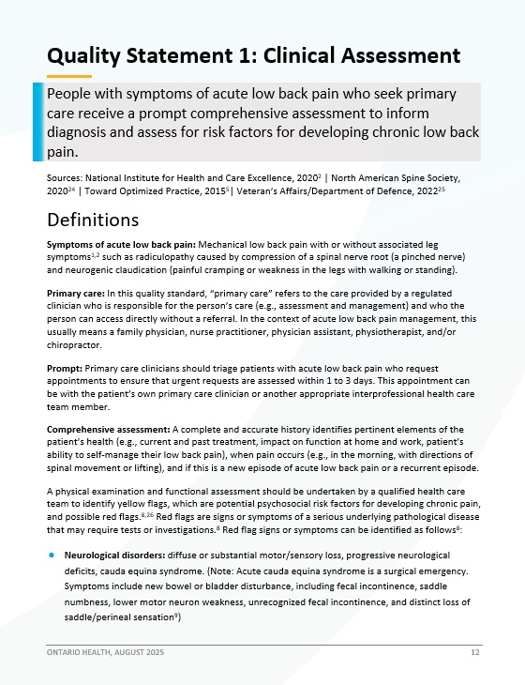
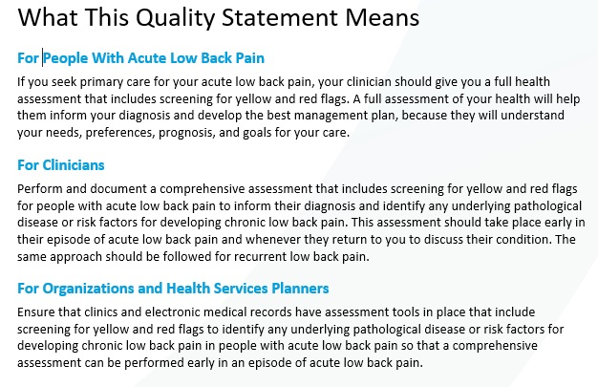
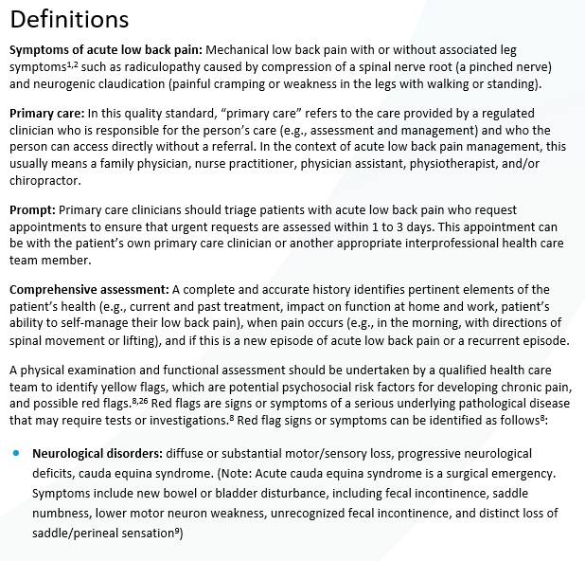
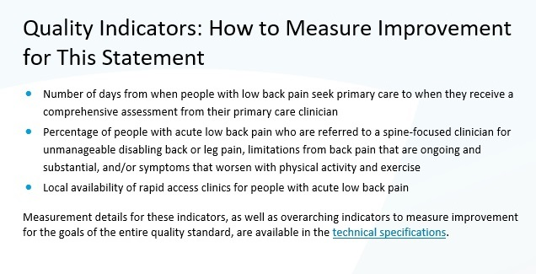
Inside the quality standard
The Quality Statement
The Audience Statements
The Definitions
The Indicators

Slide 7
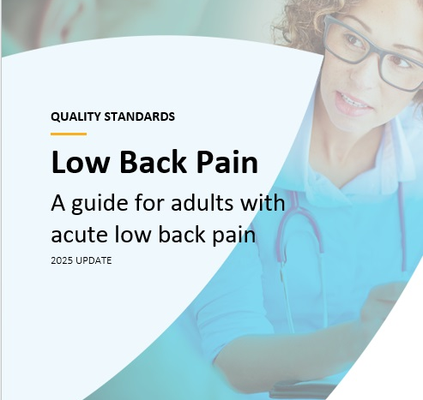
Patient guide
The patient guide is designed to give patients information about what quality care looks like for various conditions based on the best evidence, so they can ask informed questions of their health care teams.

Slide 8
Placemat
The placemat is a quick-reference resource for clinicians that summarizes the quality standard and includes links to helpful resources and tools.

Slide 9
Case for improvement deck
The case for improvement deck describes why the quality standard was created and shows some of the data used to develop it. Champions can use or adapt this deck to build support for the quality standard in their organizations.

Slide 10
How the health care system can support implementation
Implementing quality standards can be challenging owing to
system-level barriers or gaps, many of which have been identified throughout the development of this standard
Ontario Health will work with and support other provincial partners, including the Ministry of Health, to bridge system-level gaps and support the implementation of quality standards

Slide 11

Implementation tools
The Getting Started Guide:
Outlines the process for using the quality standard as a resource to deliver
high-quality care
Contains evidence-based approaches, as well as useful tools and templates for implementing change ideas at the practice level

Slide 12

Quorum
Quorum is an online community dedicated to improving the quality of health care in Ontario.
The Quality Standards Adoption Series highlights efforts in the field to implement changes and close gaps in care related to quality standard topics.

Slide 13

Measurement guide
The measurement guide describes:
The measurement principles behind the quality indicators included in quality standards
The types of indicators included in quality standards
How local and provincial data are collected and measured

Slide 14
Technical specifications
The technical specifications report outlines 2 types of measurement:
Provincial measurement: how we can monitor the progress being made to improve care at the provincial level
Local measurement: what you can do to assess the quality of care that you
provide locally

Slide 15
Why do we need a quality standard for acute low back pain?

Slide 16







Over 7 in 10 people experience acute low back pain at least once in their lifetime.
Notes: people is defined as those between the ages of 18 and 72.
Sources:
National Institute for Health and Care Excellence. Low back pain and sciatica in over 16s: assessment and management [Internet]. London (UK): The Institute; 2016 [cited 2017 Oct]. Available from: https://www.nice.org.uk/guidance/ng59
Bone and Joint Canada. Low back pain. Toronto (ON): 2014 [cited 2018 Dec]. Available from http://boneandjointcanada.com/low-back-pain
American Association of Neurological Surgeons. Low back pain. Toronto (ON): 2024 [cited 2025 May]. Available from:
https://www.aans.org/patients/conditions-treatments/low-back-pain/

Slide 17
The percentage of people who presented to a physician or the ED for a first episode of acute low back pain varies across OH Regions
In FY 2024/25, the Central and West OH Regions had the highest occurrence of people who seek physician or ED care for a first episode of acute low back pain. This has been consistent from FY 2019/20 to FY 2024/25*.
Percentage of people who seek physician or ED care for a first episode of acute low back pain in Ontario by Ontario Health Region, FY 2024/25*
3.8%
North East
1.6%
North West
18.6%
East
28.6%
Central
19.1%
Toronto
28.1%
West
Abbreviations: FY, fiscal year; ED, emergency department; OH region, Ontario Health region.
Notes: Data is based on Ontario residents who are between the ages of 16 to 120. People for a first episode of acute low back pain is defined as having no prior records for low back pain in NACRS or OHIP within the 5 years prior to the date of the index visit. Ontario Health region is determined based on patient residence. *FY 2024/25 numbers not finalized.
Sources: Ontario Health Insurance Plan Claims Database (OHIP), National Ambulatory Care Reporting System (NACRS), Registered Persons Database (RPDB).

Slide 18
From FYs 2019/20 to 2024/25, people between the ages of 26 and 34 presented to a physician or ED for a first episode of acute low back pain at higher rates than other age groups and males presented at higher rates than females
Abbreviations: FY, fiscal year; ED, emergency department.
Notes: Data is based on Ontario residents between the ages of 16 and 120. “First episode of acute low back pain” is defined as people presenting with no prior records for low back pain in NACRS or OHIP within the 5 years prior to the date of the index visit. *FY 2024/25 numbers not finalized.
Sources: Ontario Health Insurance Plan Claims Database (OHIP), National Ambulatory Care Reporting System (NACRS), Registered Persons Database (RPDB).

Slide 19


90% of acute low back pain is not caused by serious illness. Diagnostic imaging is being used more often than necessary and can expose patients to unnecessary radiation and lead to more avoidable tests and surgery.
The total cost for spinal imaging in Ontario, including x-ray examinations, CT scans and MRIs was estimated to be $45.8 million in FY 2002/03 and increased 54% to $70.3 million in FY 2018/19.
Abbreviations: CT, computed tomography; FY, fiscal year; MRI, magnetic resonance imaging.
Source: Back Care Canada. Key facts about back and back-related leg pain [Internet]. Markdale (ON): Canadian Spine Society; 2013 [cited 2017 May 23]. Available from: http://backcarecanada.ca/key-facts-about-back-andor-leg-pain
Canadian Institute for Health Information. Overuse of tests and treatments in Canada — progress report [Internet]. Ottawa (ON): CIHI; 2022 [cited 2025 18 Jun]. Available from: https://www.cihi.ca/sites/default/files/document/overuse-of-tests-and-treatments-in-canada-report-en.pdf
Al-Ghetaa RK, Alabousi M, You JJ, Emary PC, Riva JJ, Dufton J, et al. Temporal trends in spinal imaging in Ontario (2002-2019) and Manitoba (2001-2011), Canada. Cureus. 2024 Jun 27;16(6):e63267.

Slide 20
Spinal diagnostic imaging use is increasing over time
The percentage of people receiving any spinal diagnostic imaging within 180 days of visiting a physician or ED in Ontario for a first episode of acute low back pain has been increasing over time since FY 2019/20, primarily driven by increased use of x-ray imaging. Meanwhile, the use of other diagnostic spinal imaging types such as CT, MRI, and bone scans have remained relatively constant since FY 2020/21.
Abbreviations: ED, emergency department; FY, fiscal year; CT, computed tomography; MRI, magnetic resonance imaging.
Notes: Data is based on Ontario residents between the ages of 16 and 120. A first episode of acute low back pain is defined as people presenting with no prior records for low back pain in NACRS or OHIP within the 5 years prior to the date of the index visit. “Any spinal imaging” refers to the following types of diagnostic imaging of the spine: x-ray, MRI, CT, and bone scans. *FY 2024/25 numbers not finalized.
Sources: Ontario Health Insurance Plan Claims Database (OHIP), National Ambulatory Care Reporting System (NACRS), Registered Persons Database (RPDB).

Slide 21
The Northern OH regions consistently have higher levels diagnostic spinal imaging for people with acute low back pain
In FY 2024/25, the North East and North West OH regions had the highest percentages of people receiving any spinal diagnostic imaging within 180 days of visiting a physician or ED for a first episode of acute low back pain, (over 19% each). These regions had higher usages of spinal diagnostic imaging since FY 2019/20.
Abbreviations: CT, computed tomography; ED, emergency department; FY, fiscal year; MRI, magnetic resonance imaging.
Notes: Data is based on Ontario residents between the ages of 16 and 120. A first episode of acute low back pain is defined as people presenting with no prior records for low back pain in NACRS or OHIP within the 5 years prior to the date of the index visit. “Any spinal imaging” refers to the following types of diagnostic imaging of the spine: x-ray, MRI, CT, and bone scans. *FY 2024/25 numbers not finalized.
Sources: Ontario Health Insurance Plan Claims Database (OHIP), National Ambulatory Care Reporting System (NACRS), Registered Persons Database (RPDB).

Slide 22
People who are older have higher levels of diagnostic spinal imaging for people with acute low back pain
Between FYs 2019/20 and 2023/24, people 70 years of age and over who sought physician or ED care for a first episode of acute low back pain underwent spinal diagnostic imaging within 180 days at a higher rate than any other age group.
Abbreviations: CT, computed tomography; ED, emergency department; FY, fiscal year; MRI, magnetic resonance imaging.
Notes: Data is based on Ontario residents between the ages of 16 and 120. A first episode of acute low back pain is defined as people presenting with no prior records for low back pain in NACRS or OHIP within the 5 years prior to the date of the index visit. “Any spinal imaging” refers to the following types of diagnostic imaging of the spine: x-ray, MRI, CT, and bone scans.*FY 2024/25 numbers are not finalized.
Sources: Ontario Health Insurance Plan Claims Database (OHIP), National Ambulatory Care Reporting System (NACRS), Registered Persons Database (RPDB).

Slide 23
Emergency department visits for acute low back pain are higher for people who live in higher income neighbourhoods
In FY 2024/25, people living in higher income neighbourhoods sought physician or ED care for a first episode of acute low back pain and revisited the ED for low back pain within 90 days at higher rates than those from lower income neighbourhoods. This trend is consistent in all FYs since 2019/20.
Abbreviations: FY, fiscal year; ED, emergency department.
Notes: Data is based on Ontario residents between the ages of 16 and 120. A first episode of acute low back pain is defined as people presenting with no prior records for low back pain in NACRS or OHIP within the 5 years prior to the date of the index visit. Types of diagnostic imaging of the spine defined as x-ray, MRI, CT, and bone scans. Income quintile is an area-based ranking of the household income in each neighbourhood of residence, compared to surrounding neighbourhoods. *FY 2024/25 numbers not finalized.
Sources: Ontario Health Insurance Plan Claims Database (OHIP), National Ambulatory Care Reporting System (NACRS), Registered Persons Database (RPDB).

Slide 24

Opioid prescribing for acute low back pain
Acute low back pain is the most common reason opioids are prescribed in family medicine and the emergency department.
Source: Borgundvaag B, McLeod S, Khuu W, Varner C, Tadrous M, Gomes T. Opioid prescribing and adverse events in opioid-naive patients treated by emergency physicians versus family physicians: a population-based cohort study. CMAJ Open. 2018;6(1):e110-7.

Slide 25
There has been a decrease in opioid medication prescribing; however, the northern OH regions and Ontarians over the age of 70 continued to experience higher rates than other regions and age groups between FYs 2019/20 and 2024/25
Opioid prescribing after a visit to a physician or ED for a first episode of acute low back pain between FYs 2019/20 and 2024/25 has decreased overall. However, Ontarians over the age of 70 and Ontarians residing in the northern OH regions had higher rates of opioid medication prescribing.
Percentage of people who seek physician or ED care for a first episode of acute low back pain who are prescribed
an opioid medication within 90 days of the date of the index visit, FYs 2019/20 to 2024/25
Abbreviations: FY, fiscal year; ED, emergency department.
Notes: Data is based on Ontario residents between the ages of 16 and 120. A first episode of acute low back pain is defined as people presenting with no prior records for low back pain in
NACRS or OHIP within the 5 years prior to the date of the index visit. Ontario Health region is determined by patient residence. *FY 2024/25 numbers not finalized.
Sources: Ontario Health Insurance Plan Claims Database (OHIP), National Ambulatory Care Reporting System (NACRS), Registered Persons Database (RPDB).

Slide 26
Opioid medications are prescribed in higher percentages for people with acute low back pain who live in higher income neighbourhoods
In FY 2024/25, people living in higher income neighbourhoods had higher rates of opioid prescribing
within 90 days of seeking physician or ED care for a first episode of acute low back pain than those
from lower income neighbourhoods. This trend is consistent in all FYs since 2019/20.
Abbreviations: FY, fiscal year; ED, emergency department.
Notes: Data is based on Ontario residents between the ages of 16 and 120. A first episode of acute low back pain is defined as people presenting with no prior records for low back pain in NACRS or OHIP within the 5 years prior to the date of the index visit. Income quintile is an area-based ranking of the household income in each neighbourhood of residence, compared to surrounding neighbourhoods. *FY 2024/25 numbers not finalized.
Sources: Ontario Health Insurance Plan Claims Database (OHIP), National Ambulatory Care Reporting System (NACRS), Registered Persons Database (RPDB).

Slide 27
Quotation from advisory committee member
”
“This quality standard offers a unified approach to managing low-back pain for patients across Ontario; it will help health professionals work as a team to do what’s best for the system and their patients. Moreover, it represents an opportunity for clinicians and patients to refer to the same sources of information, offering a common ground.
“Patient education is necessary for engagement – recovery and prevention depend on it. Low back pain is a complicated issue, with many factors at play, and it’s important that when the patient leaves the appointment, they understand the diagnosis and the appropriate next steps, particularly the importance of movement and physical activity, available adjunctive therapies, and the reasons why imaging and pharmacological treatment are usually unnecessary.”
– Scott Shallow, Low Back Pain Quality Standard Advisory Committee member

Slide 28
Quality statements to improve care

Slide 29
Scope of this quality standard
Acute low back pain is defined as pain localized between the 12th rib and the inferior gluteal folds and is considered nonspecific, characterized by tension, soreness, or stiffness in the low back area
This quality standard addresses care for adults 16 years of age or older who have a first episode of acute low back pain, or a recurrent episode of acute low back pain that lasts less than 12 weeks, with or without leg symptoms
This quality standard focuses on the assessment of acute low back pain and risk factors to prevent chronic low back pain, as well as physical activity, education, self-management, and psychosocial support for people with acute low back pain across all health care settings and health care teams
This quality standard does not address chronic low back pain (greater than 12 weeks in duration), back pain in pregnancy, inflammatory conditions, infections, fracture, neoplasm, bone disease, non-spinal causes, or surgical interventions

Slide 30
Quality statement topics
Clinical assessment
Diagnostic imaging
Patient education and self-management
Maintaining usual activity
Psychosocial information and support
Pharmacological therapies
Additional nonpharmacological therapies

Slide 31
Quality statement (QS) 1: Clinical assessment
People with symptoms of acute low back pain who seek primary care receive a prompt comprehensive assessment to inform diagnosis and assess for risk factors for developing chronic low back pain.

Slide 32
QS 2: Diagnostic imaging
People with acute low back pain do not receive diagnostic imaging tests unless they present with red flags that suggest serious pathological disease.

Slide 33
QS 3: Patient education and self-management
People with acute low back pain are offered education and ongoing support for self-management that is tailored to their individual needs and abilities.

Slide 34
QS 4: Maintaining usual activity
People with acute low back pain are encouraged to stay physically active by continuing to perform activities of daily living, with modification if required to maintain or improve mobility and function.

Slide 35
QS 5: Psychosocial information and support
People with acute low back pain who have psychosocial barriers to recovery (yellow flags) identified during their comprehensive assessment are offered further information and support to manage the identified barriers.

Slide 36
QS 6: Pharmacological therapies
People with acute low back pain whose symptoms do not adequately improve with physical activity, education, reassurance, and self-management support are offered information on the risks and benefits of nonopioid analgesics to improve mobility and function.

Slide 37
QS 7: Additional nonpharmacological therapies
People with acute low back pain whose symptoms do not adequately improve with physical activity, education, reassurance, and self-management support are offered information on the risks and benefits of additional nonpharmacological therapies to improve mobility and function.

Slide 38
Measures to support improvement

Slide 39
Indicators that can be measured using provincial data
Percentage of people who seek physician or emergency department care for a first episode of acute low back pain who undergo diagnostic imaging of the spine (x-ray, computed tomography [CT], magnetic resonance imaging [MRI], bone scan) within 90 days and 180 days of the date of the index visit
Percentage of people who seek physician or emergency department care for a first episode of acute low back pain who are prescribed an opioid medication within 7 days and 90 days of the date of the index visit
Percentage of people who seek physician or emergency department care for a first episode of acute low back pain who subsequently present to the emergency department for low back pain within 30 days and 90 days of the date of the index visit

Slide 40
Indicators that can be measured using only local data
Percentage of people with acute low back pain who have surgeon or specialist consultations within 90 days of a low back pain diagnosis
Percentage of people with acute low back pain who report an improvement in their quality of life
Percentage of people with acute low back pain who rate their interaction with their clinicians as “definitely helping them feel better able to manage their low back pain” (response options: definitely, for the most part, somewhat, not at all)

Slide 41
Data sources and acknowledgement
The data used in this presentation were provided by the Canadian Institute for Health Information (CIHI). Ontario Health Insurance Plan claims data are provided by the Institute for Clinical Evaluative Sciences (ICES), and the Registered Persons Database is provided by the Ontario Ministry of Health. However, the analyses, conclusions, opinions, and statements expressed herein are those of the authors and not necessarily those of CIHI, ICES, or the Ministry of Health.

Slide 42
Thank you

